Slide 1
Built-in directives
Hardeep Kaur Dhalla

Slide 2
Objectives
Event Binding – how to pass event data?
Build-in Directives

Slide 3
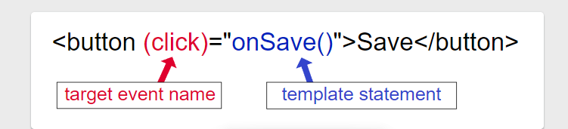
Event Binding
Event binding lets you listen for and respond to user actions such as keystrokes, mouse movements, clicks, and touches.

Slide 4
Passing event information
To handle events, pass the event object, $event, to the method handling the event.
Example: <input (input)=“someMethod($event)">

Slide 5
Event Handling
TypeScript class
someMethod(event: Event): string {
return (event.target as HTMLInputElement).value;
}
Or
someMethod(event: Event): string {
return (< HTMLInputElement >event.target).value;
}

Slide 6
Built-in directives
Directives are classes that add additional behavior to html elements in your Angular applications.
Use Angular's built-in directives to manage forms, lists, styles, and what users see.

Slide 7
Built-in attribute directives
Attribute directives listen to and modify the behavior of other HTML elements, attributes, properties, and components.
The most common attribute directives are as follows:
NgClass—adds and removes a set of CSS classes.
NgStyle—adds and removes a set of HTML styles.
NgModel—adds two-way data binding to an HTML form element.

Slide 8
NgModel
.
Use the NgModel directive to display a data property and update that property when the user makes changes.
adds two-way data binding to an HTML form element.
We will use it in two-way data binding.

Slide 9
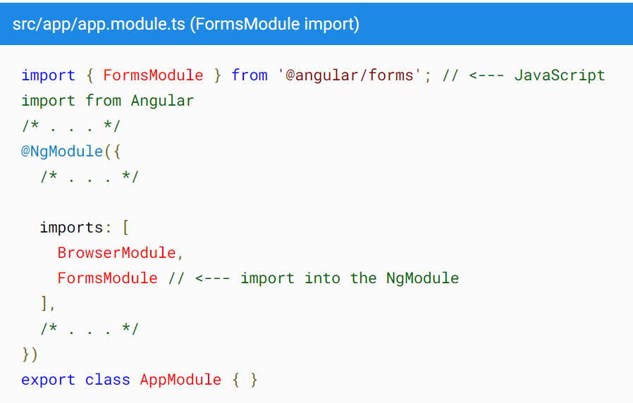
NgModel
Import FormsModule and add it to the NgModule's imports list.

Slide 10
NgModel
Two-way binding syntax is a combination of square brackets and parentheses, [()].
Also known as 'banana-in-a-box syntax’.
Example:
<input name="name" type="text" [(ngModel)]="productName"/>

Slide 11
Built-in structural directives
They shape or reshape the DOM's structure, typically by adding, removing, and manipulating the host elements to which they are attached.
The most common built-in structural directives are:
NgIf—conditionally creates or disposes of subviews from the template.
NgFor—repeat a node for each item in a list.
NgSwitch—a set of directives that switch among alternative views.

Slide 12
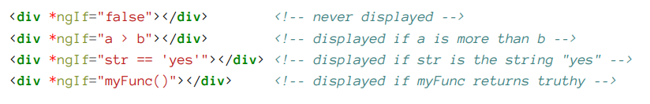
NgIf
The ngIf directive is used when you want to add or remove an element to DOM based on a condition.
By default, NgIf prevents display of an element bound to a null value.

Slide 13
NgSwitch
a set of directives that switch among alternative views.
NgSwitch is a set of three directives:
NgSwitch—an attribute directive that changes the behavior of its companion directives.
NgSwitchCase—structural directive that adds its element to the DOM when its bound value equals the switch value and removes its bound value when it doesn't equal the switch value.
NgSwitchDefault—structural directive that adds its element to the DOM when there is no selected NgSwitchCase.
Having the ngSwitchDefault element is optional.

Slide 14
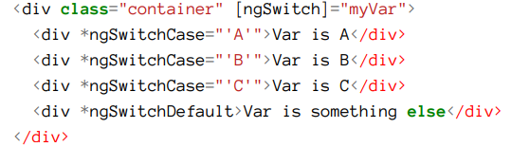
NgSwitch
Example

Slide 15
NgFor
The role of this directive is to repeat a given DOM element/s and pass an element of the array on each iteration.
DOM elements being created and destroyed.
The syntax is *ngFor="let item of items".
The let item syntax specifies a (template) variable that’s receiving each element of the items array;
The items is the collection of items from your controller.

Slide 16

How to render a list?
To do this, we will use *ngFor directives, which will
iterate over a list of items and
generate a new tag for each one.

Slide 17

Getting an index
In the *ngFor, add a semicolon and let i=index to the shorthand.

Slide 18
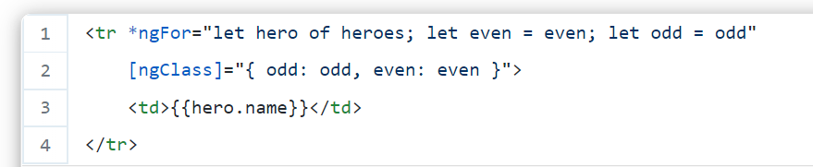
Other variables for ngFor
Odd
Even
Maybe you want to add a different CSS class for even and odd rows

Slide 19
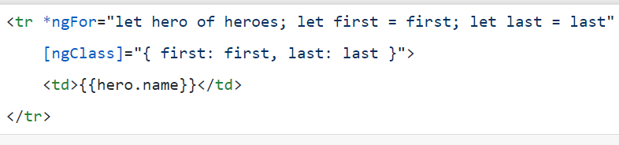
Other variables for ngFor
First
last
can be used to identify the first and the last elements of the list

Slide 20
Template statements
Difference between template expression and statement
In addition, the template statements parser specifically supports both basic assignment, =, and chaining expressions with semicolons, ;.
References
https://angular.io/guide/template-statements
https://angular.io/guide/interpolation#template-expressions

Slide 21
References
https://angular.io/guide/built-in-directives
https://blog.angular-university.io/angular-2-ngfor/

